Slide 1

CS375 – Information Security
Lecture 6
Public-Key Cryptography & RSA
Dr. Anwar Ghani
Lecturer
Department of Computer Science & SE
Internal Islamic University, Islamabad
Email: anwar.ghani@iiu.edu.pk

Slide 2
Private-Key Cryptography
Traditional private/secret/single key cryptography uses one key
Shared by both sender and receiver
If this key is disclosed communications are compromised
Also is symmetric, parties are equal
Does not protect sender from receiver forging a message & claiming is sent by sender
CS375 IS - Spring 2021
Notes:
So far all the cryptosystems discussed, from earliest history to modern times, have been private/secret/single key (symmetric) systems.
All classical, and modern block and stream ciphers are of this form, and still rely on the fundamental building blocks of substitution and permutation (transposition).

Slide 3
Public-Key Cryptography
Most significant advance in the history of cryptography
Uses two keys – a public & a private key
Asymmetric since parties are not equal
Uses number theory
Developed to address two issues
  key distribution
    how to have secure communications without having to trust a KDC with your key
  digital signatures
    how to verify a message comes intact from the claimed sender
CS375 IS - Spring 2021
Notes:
Will now discuss the radically different public key systems, in which two keys are used. The development of public-key cryptography is the greatest and perhaps the only true revolution in the entire history of cryptography. It is asymmetric, involving the use of two separate keys, in contrast to symmetric encryption,which uses only one key. Anyone knowing the public key can encrypt messages or verify signatures, but cannot decrypt messages or create signatures, counter-intuitive though this may seem. It works by the clever use of number theory problems that are easy one way but hard the other. Note that public key schemes are neither more nor less secure than private key (security depends on the key size for both), nor do they replace private key schemes (they are too slow to do so), rather they complement them. Both also have issues with key distribution, requiring the use of some suitable protocol.

Slide 4
Public-Key Cryptography
Public-key/two-key/asymmetric cryptography involves the use of two keys
  public-key, which may be known to anybody, and can be used to encrypt messages, and verify signatures
  private-key, known only to the recipient, used to decrypt messages, and sign (create) signatures
Asymmetric
  those who encrypt messages or verify signatures cannot decrypt messages or create signatures
CS375 IS - Spring 2021
Notes:
Emphasize here the radical difference with Public-Key Cryptography is the use of two related keys but with very different roles and abilities. Anyone knowing the public key can encrypt messages or verify signatures, but cannot decrypt messages or create signatures, all thanks to some clever use of number theory.

Slide 5
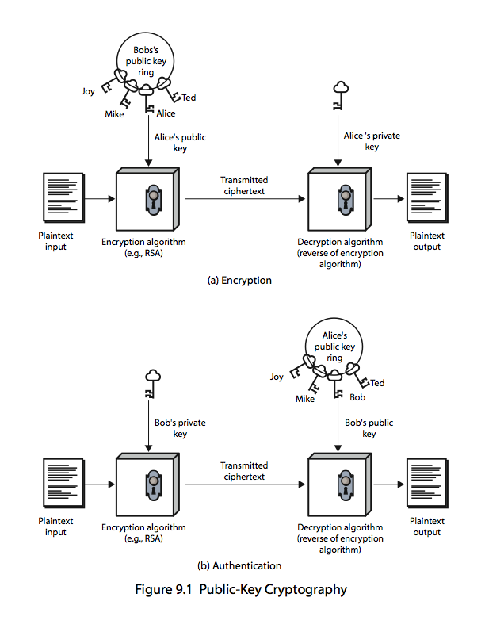
Public-Key Cryptography (Encryption)
CS375 IS - Spring 2021
Notes:
Stallings Figure 9.1a “Public-Key Cryptography”, shows that a public-key encryption scheme has six ingredients: plaintext, encryption algorithm, public & private keys, ciphertext & decryption algorithm.
Consider the following analogy using padlocked boxes: traditional schemes involve the sender putting a message in a box and locking it, sending that to the receiver, and somehow securely also sending them the key to unlock the box. The radical advance in public key schemes was to turn this around, the receiver sends an unlocked box (their public key) to the sender, who puts the message in the box and locks it (easy - and having locked it cannot get at the message), and sends the locked box to the receiver who can unlock it (also easy), having the (private) key. An attacker would have to pick the lock on the box (hard).

Slide 6
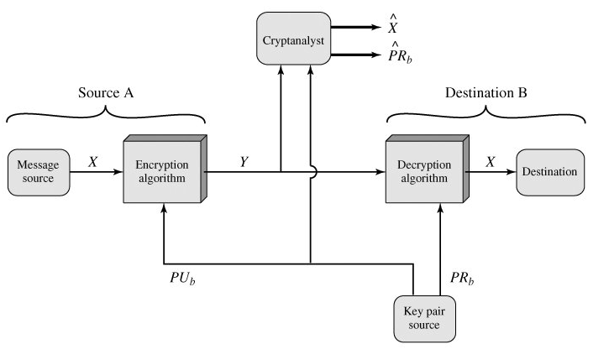
Public-Key Cryptosystem (Secrecy)
CS375 IS - Spring 2021
Notes:
Stallings Figure 9.1a “Public-Key Cryptography”, shows that a public-key encryption scheme has six ingredients: plaintext, encryption algorithm, public & private keys, ciphertext & decryption algorithm.
Consider the following analogy using padlocked boxes: traditional schemes involve the sender putting a message in a box and locking it, sending that to the receiver, and somehow securely also sending them the key to unlock the box. The radical advance in public key schemes was to turn this around, the receiver sends an unlocked box (their public key) to the sender, who puts the message in the box and locks it (easy - and having locked it cannot get at the message), and sends the locked box to the receiver who can unlock it (also easy), having the (private) key. An attacker would have to pick the lock on the box (hard).

Slide 7
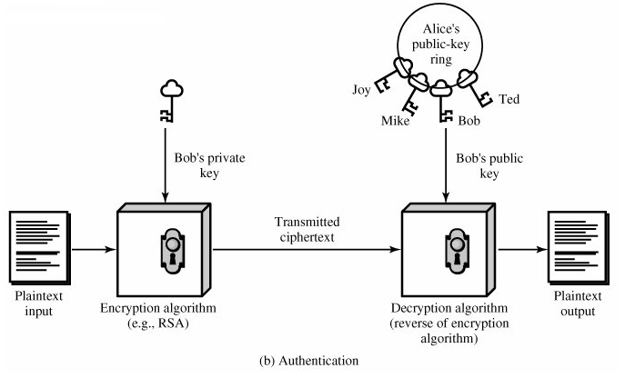
Public-Key Cryptography (Authentication)
CS375 IS - Spring 2021
Notes:
Stallings Figure 9.1a “Public-Key Cryptography”, shows that a public-key encryption scheme has six ingredients: plaintext, encryption algorithm, public & private keys, ciphertext & decryption algorithm.
Consider the following analogy using padlocked boxes: traditional schemes involve the sender putting a message in a box and locking it, sending that to the receiver, and somehow securely also sending them the key to unlock the box. The radical advance in public key schemes was to turn this around, the receiver sends an unlocked box (their public key) to the sender, who puts the message in the box and locks it (easy - and having locked it cannot get at the message), and sends the locked box to the receiver who can unlock it (also easy), having the (private) key. An attacker would have to pick the lock on the box (hard).

Slide 8
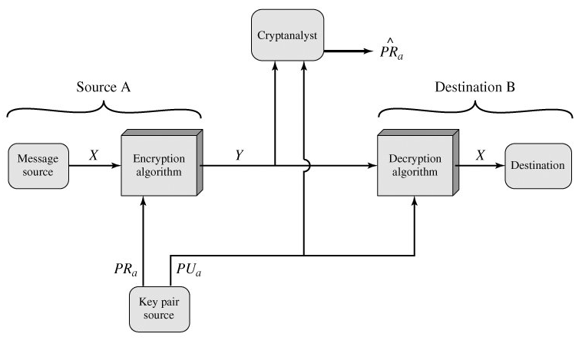
Public-Key Cryptosystem (Authentication)
CS375 IS - Spring 2021
Notes:
Stallings Figure 9.1a “Public-Key Cryptography”, shows that a public-key encryption scheme has six ingredients: plaintext, encryption algorithm, public & private keys, ciphertext & decryption algorithm.
Consider the following analogy using padlocked boxes: traditional schemes involve the sender putting a message in a box and locking it, sending that to the receiver, and somehow securely also sending them the key to unlock the box. The radical advance in public key schemes was to turn this around, the receiver sends an unlocked box (their public key) to the sender, who puts the message in the box and locks it (easy - and having locked it cannot get at the message), and sends the locked box to the receiver who can unlock it (also easy), having the (private) key. An attacker would have to pick the lock on the box (hard).

Slide 9
Public-Key Characteristics
Public-Key algorithms rely on two keys where:
  it is computationally infeasible to find decryption key knowing only algorithm & encryption key
  it is computationally easy to en/decrypt messages when the relevant (en/decrypt) key is known
  either of the two related keys can be used for encryption, with the other used for decryption (for some algorithms)
CS375 IS - Spring 2021
Notes:
Asymmetric algorithms rely on one key for encryption and a different but related key for decryption. These algorithms have the following important characteristic: that it is computationally infeasible to determine the decryption key given only knowledge of the cryptographic algorithm and the encryption key. That is public key schemes utilise problems that are easy (P type) one way but hard (NP type) the other way, eg exponentiation vs logs, multiplication vs factoring. In addition, some algorithms, such as RSA, are also able to use either key as public & other private.

Slide 10

Public-Key Cryptosystems
CS375 IS - Spring 2021
Notes:
Stallings Figure 9.4 “Public-Key Cryptosystems: Secrecy and Authentication” illustrates the essential elements of a public-key encryption scheme.
Note that public-key schemes can be used for either secrecy or authentication, or both (as shown here).
In this case, separate key pairs are used for each of these purposes. The receiver owns and creates secrecy keys, sender owns and creates authentication keys.
In practice typically DO NOT do this, because of the computational cost of public-key schemes. Rather encrypt a session key which is then used with a block cipher to encrypt the actual message, and separately sign a hash of the message as a digital signature - this will be discussed more later.

Slide 11
Public-Key Applications
Can classify uses into 3 categories:
  encryption/decryption (provide secrecy)
  digital signatures (provide authentication)
  key exchange (of session keys)
Some algorithms are suitable for all uses, others are specific to one
CS375 IS - Spring 2021
Notes:
Public-key systems are characterized by the use of a cryptographic type of algorithm with two keys. Depending on the application, the sender uses either the sender’s private key or the receiver’s public key, or both, to perform some type of cryptographic function. In broad terms, we can classify the use of public-key cryptosystems into the three categories:
• Encryption/decryption: The sender encrypts a message with the recipient’s public key.
• Digital signature: The sender “signs”a message with its private key, either to the whole message or to a small block of data that is a function of the message.
• Key exchange: Two sides cooperate to exchange a session key. Several different approaches are possible, involving the private key(s) of one or both parties.
Some algorithms are suitable for all three applications, whereas others can be used only for one or two of these applications.

Slide 12
Security of Public Key Schemes
Like private key schemes brute force exhaustive search attack is always theoretically possible
But keys used are too large (>512bits)
Security relies on a large enough difference in difficulty between easy (en/decrypt) and hard (cryptanalysis) problems
More generally the hard problem is known, but is made hard enough to be impractical to break
Requires the use of very large numbers
Hence is slow compared to private key schemes
CS375 IS - Spring 2021
Notes:
Public key schemes are no more or less secure than private key schemes - in both cases the size of the key determines the security. Note also that you can't compare key sizes - a 64-bit private key scheme has very roughly similar security to a 512-bit RSA - both could be broken given sufficient resources. But with public key schemes at least there is usually a firmer theoretical basis for determining the security since its based on well-known and well studied number theory problems.

Slide 13
The RSA Algorithm
By Rivest, Shamir & Adleman of MIT in 1977
Best known & widely used public-key scheme
Based on exponentiation in a finite (Galois) field over integers modulo a prime
  e.g. exponentiation takes O((log n)³) operations (easy)
Uses large integers (e.g. 1024 bits)
Security due to cost of factoring large numbers
  e.g. factorization takes O(e ^{log n log log n}) operations (hard)
CS375 IS - Spring 2021
Notes:
RSA is the best known, and by far the most widely used general public key encryption algorithm, and was first published by Rivest, Shamir & Adleman of MIT in 1978 [RIVE78]. Since that time RSA has reigned supreme as the most widely accepted and implemented general-purpose approach to public-key encryption. It is based on exponentiation in a finite (Galois) field over integers modulo a prime, using large integers (eg. 1024 bits). Its security is due to the cost of factoring large numbers.

Slide 14
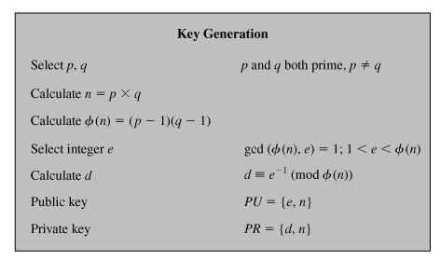
The RSA Algorithm
CS375 IS - Spring 2021
Notes:
RSA is the best known, and by far the most widely used general public key encryption algorithm, and was first published by Rivest, Shamir & Adleman of MIT in 1978 [RIVE78]. Since that time RSA has reigned supreme as the most widely accepted and implemented general-purpose approach to public-key encryption. It is based on exponentiation in a finite (Galois) field over integers modulo a prime, using large integers (eg. 1024 bits). Its security is due to the cost of factoring large numbers.

Slide 15
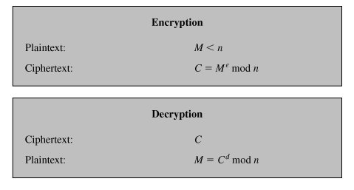
The RSA Algorithm
CS375 IS - Spring 2021
Notes:
RSA is the best known, and by far the most widely used general public key encryption algorithm, and was first published by Rivest, Shamir & Adleman of MIT in 1978 [RIVE78]. Since that time RSA has reigned supreme as the most widely accepted and implemented general-purpose approach to public-key encryption. It is based on exponentiation in a finite (Galois) field over integers modulo a prime, using large integers (eg. 1024 bits). Its security is due to the cost of factoring large numbers.

Slide 16
RSA Key Setup
Each user generates a public/private key pair by
Selecting two large primes at random - p, q
Computing their system modulus n=p.q
  note ø(n)=(p-1)(q-1)
Selecting at random the encryption key e
    where 1<e<ø(n), gcd(e,ø(n))=1
Solve following equation to find decryption key d
  e.d=1 mod ø(n) and 0≤d≤n
Publish their public encryption key: PU={e,n}
Keep secret private decryption key: PR={d,n}
CS375 IS - Spring 2021
Notes:
RSA key setup is done once (rarely) when a user establishes (or replaces) their public key, using the steps as shown. The exponent e is usually fairly small, just must be relatively prime to ø(n). Need to compute its inverse mod ø(n) to find d. It is critically important that the factors p & q of the modulus n are kept secret, since if they become known, the system can be broken. Note that different users will have different moduli n.

Slide 17
RSA Use
To encrypt a message M the sender:
  obtains public key of recipient PU={e,n}
  computes: C = Me mod n, where 0≤M<n
To decrypt the ciphertext C the owner:
  uses their private key PR={d,n}
  computes: M = C^{d} mod n
Note that the message M must be smaller than the modulus n (block if needed)
CS375 IS - Spring 2021
Notes:
The actual RSA encryption and decryption computations are each simply a single exponentiation mod (n). Note that the message must be smaller than the modulus. The “magic” is in the choice of the exponents which makes the system work.

Slide 18
RSA Example - Key Setup
Select two primes: p=17 & q=11
Compute n = pq =17 x 11=187
Compute ø(n)=(p–1)(q-1)=16 x 10=160
Select e: gcd(e,160)=1 choose e=7
Determine d: de=1 mod 160 and d < 160 Value of d=23 since 23x7=161= 10x160+1
Publish public key PU={7,187}
Keep secret private key PR={23,187}
CS375 IS - Spring 2021
Notes:
Here walk through example RSA key generation using “trivial” sized numbers.
Selecting primes requires the use of a primality test.
Finding d as inverse of e mod ø(n) requires use of Euclid’s Inverse algorithm (see Ch4)

Slide 19
RSA Example - En/Decryption
Sample RSA encryption/decryption is
Given message M = 88 (such that 88<187)
Encryption:
  C = 88⁷ mod 187 = 11
Decryption:
  M = 11²³ mod 187 = 88
CS375 IS - Spring 2021
Notes:
Then show that the encryption and decryption operations are simple exponentiations mod 187.
Rather than having to laborious repeatedly multiply, can use the "square and multiply" algorithm with modulo reductions to implement all exponentiations quickly and efficiently (see next).

Slide 20
Efficient Encryption
Encryption uses exponentiation power of e
Hence if e is small, this will be faster
  often choose e = 65537 (2¹⁶-1)
  also see choices of e = 3 or e = 17
But if e is too small (e.g. e = 3) can attack
  using Chinese remainder theorem & 3 messages with different modulii
If e is fixed must ensure gcd(e, ø(n))=1
  i.e. reject any p or q not relatively prime to e
CS375 IS - Spring 2021
Notes:
To speed up the operation of the RSA algorithm using the public key, can choose to use a small value of e (but not too small, since its then vulnerable to attack).
Must then ensure any p or q chosen are relatively prime to the fixed e (and reject and find another if not), for system to work.

Slide 21
Efficient Decryption
Decryption uses exponentiation power of d
  this is likely large, insecure if not
Can use the Chinese Remainder Theorem (CRT) to compute mod p & q separately. then combine to get desired answer
  approx 4 times faster than doing directly
Only owner of private key who knows values of p & q can use this technique
CS375 IS - Spring 2021
Notes:
To speed up the operation of the RSA algorithm using the private key, can use the Chinese Remainder Theorem (CRT) to compute mod p & q separately, and then combine results to get the desired answer. This is approx 4 times faster than calculating “C^d mod n” directly. Note that only the owner of the private key details (who knows the values of p & q) can do this, but of course that’s exactly where help is needed, since if e is small then d will be likely be large!

Slide 22
RSA Key Generation
Users of RSA must
  determine two primes at random - p, q
  select either e or d and compute the other
Primes p,q must not be easily derived from modulus n=p.q
  means must be sufficiently large
  typically guess and use probabilistic test
Exponents e, d are inverses, so use Inverse algorithm to compute the other
CS375 IS - Spring 2021
Notes:
Before the application of the public-key cryptosystem, each participant must generate a pair of keys, which requires finding primes and computing inverses. Both the prime generation and the derivation of a suitable pair of inverse exponents may involve trying a number of alternatives. Typically make random guesses for a possible p or q, and check using a probabalistic primality test whether the guessed number is indeed prime. If not, try again. Note that the prime number theorem shows that the average number of guesses needed is not too large. Then compute decryption exponent d using Euclid’s Inverse Algorithm, which is quite efficient.

Slide 23
RSA Security
Possible approaches to attacking RSA are:
  brute force key search (infeasible given size of numbers)
  mathematical attacks (based on difficulty of computing ø(n), by factoring modulus n)
  timing attacks (on running of decryption)
  chosen ciphertext attacks (given properties of RSA)
CS375 IS - Spring 2021
Notes:
Note some possible possible approaches to attacking the RSA algorithm, as shown.
The defense against the brute-force approach is the same for RSA as for other cryptosystems, namely, use a large key space. Thus the larger the number of bits in d, the better. However because the calculations involved both in key generation and in encryption/decryption are complex, the larger the size of the key, the slower the system will run.
Will now review the other possible types of attacks.

Slide 24
Factoring Problem
Mathematical approach takes 3 forms:
  factor n=p.q, hence compute ø(n) and then d
  determine ø(n) directly and compute d
  find d directly
Currently believe all equivalent to factoring
  have seen slow improvements over the years
  biggest improvement comes from improved algorithm
  currently assume 1024–2048-bit RSA is secure
CS375 IS - Spring 2021
Notes:
We can identify three approaches to attacking RSA mathematically, as shown. Mathematicians currently believe all equivalent to factoring.
See Stallings Table 9.4 for progress in factoring, where see slow improvements over the years, with the biggest improvements coming from improved algorithms.
The best current algorithm is the “Lattice Sieve” (LS), which replaced the “Generalized Number Field Sieve” (GNFS), which replaced the “Quadratic Sieve”(QS).
Have to assume computers will continue to get faster, and that better factoring algorithms may yet be found.
Numbers of size 1024-2048 bits look reasonable at present, provided the factors meet other constraints.

Slide 25
Timing Attacks
Developed by Paul Kocher in mid-1990’s
Exploit timing variations in operations
  eg. multiplying by small vs large number
  or IF's varying which instructions executed
Infer operand size based on time taken
RSA exploits time taken in exponentiation
Countermeasures
  use constant exponentiation time
  add random delays
  blind values used in calculations
CS375 IS - Spring 2021
Notes:
Had a new category of attacks developed by Paul Kocher in mid-1990’s, based on observing how long it takes to compute the cryptographic operations. Timing attacks are applicable not just to RSA, but to other public-key cryptography systems. This attack is alarming for two reasons: It comes from a completely unexpected direction and it is a ciphertextonly attack. A timing attack is somewhat analogous to a burglar guessing the combination of a safe by observing how long it takes for someone to turn the dial from number to number.
Although the timing attack is a serious threat, there are simple countermeasures that can be used, including using constant exponentiation time algorithms, adding random delays, or using blind values in calculations.

Slide 26
Question?
CS375 IS - Spring 2021
Notes:
Had a new category of attacks developed by Paul Kocher in mid-1990’s, based on observing how long it takes to compute the cryptographic operations. Timing attacks are applicable not just to RSA, but to other public-key cryptography systems. This attack is alarming for two reasons: It comes from a completely unexpected direction and it is a ciphertextonly attack. A timing attack is somewhat analogous to a burglar guessing the combination of a safe by observing how long it takes for someone to turn the dial from number to number.
Although the timing attack is a serious threat, there are simple countermeasures that can be used, including using constant exponentiation time algorithms, adding random delays, or using blind values in calculations.

